Slide 1
CSC6032 – Advanced Operating Systems
Prof. Yeh-Ching Chung
School of Data Science
Chinese University of Hong Kong, Shenzhen

Slide 2
虛擬化技術 Virtualization Techniques
Software Virtualization
Virtual Desktop Infrastructure

Slide 3
Agenda
Overview
Virtual Desktop Infrastructure
Concept
Challenge
Case Study
VMware VDI
Citrix XenDesktop
Ulteo OVD

Slide 4
Overview
Traditional Desktop
What Kinds of Desktop Do People Need Now?

Slide 5
Typical Desktop Deployment
User data & preferences
Desktop Management
X
Tightly
Coupled
1. procure
8. retire
X
X
Profile
Apps
2. image
7. back-up
Applications
Windows
3. secure
6. maintain
Hardware
Locally Installed
4. deploy
5. monitor
Tight binding between layers
The components are linked together in ways that are difficult to support and maintain
Existing methods, tools, and processes
Operating System
A problem at one layer often causes a chain reaction
May destroy the whole stack
Make recovery difficult
Threaten any locally stored user data and settings
Most organizations just replace or re-image the whole PC
Notes:
Lets look at the problem so that we might be able to establish how to address them.
Typical desktop deployment involves the administrator giving the user a desktop machine. And its typically got a corporate image put onto it with customizations to the OS that the admin has specified along with the applications required for that end user.
You give it to the end user, and they develop a profile on it, basically storing data, sometimes in their profile, sometimes outside.
They may have the ability to install applications (if given the right to), and they may be modifying applications and so forth.
What happens is that whole stack (OS, apps, profile) becomes very tightly coupled together and its only resident on that local machine. It becomes very difficult to maintain a complete picture of what is on that machine from the data center.
You may be familiar with trying to implement roaming profiles….that is very challenging.
Now the desktop that you provided the user has become customized, it takes a lot longer to roll out applications because when you do the app regression testing, you now have a huge number of variables to take into consideration before you roll out that application. That becomes very time consuming and very expensive.
If you take these problems into consideration, you end up with hundreds of images and vast image complexity.
And it means high touch re-imaging whenever a user has to replace their machine and you’ve got a heavy test load.
As a side note, we think customers are going to be reevaluating the way that they look at desktops as a result of end users driving the demand for Vista. While companies aren’t rolling out Vista in the immediate future, in many cases its been pushed back a bit. That will likely be demanded by the end user community.

Slide 6
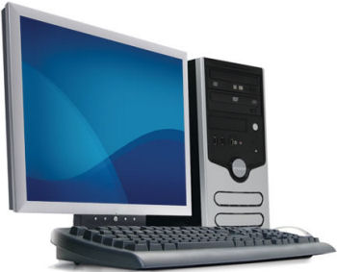
Traditional Desktop Infrastructure Challenges
Difficult to manage
Variety of PC hardware and users’ need
Broadly distributed PC hardware
Inefficient resource utilization
The distributed nature of PCs
High total cost of ownership
High cost of PC management and support
Lack of standardization and the need for support personnel to troubleshoot issues
Difficult to protect and secure data
Data back-up and data restored when PCs are failed or files are lost
The risk of PC theft threatens the security of important data

Slide 7
Overview
Traditional Desktop
What Kind of Desktop Do People Need Now?

Slide 8
For End Users
What do end users want for their PC?
Increased mobility
Anywhere access
Device independence
Roam across PCs
Consumerization
More workspace freedom
Flexible configurations
Access through own devices

Slide 9
For IT Pros
What do IT pros want for their PC?
Security and compliance
Stolen laptops and data loss
Stringent regulation
Protection of IT environment
Cost reduction
Increased computing complexity
Escalating operational costs
Disaster recovery

Slide 10
Virtual Desktop Infrastructure
So, here comes …

Slide 11
Agenda
Overview
Virtual Desktop Infrastructure
Concept
Challenge
Case Study
VMware VDI
Citrix XenDesktop
Ulteo OVD

Slide 12
Concept
What is VDI?
Composition of VDI
Advantages and Disadvantage

Slide 13
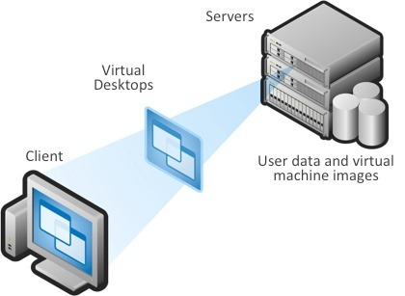
A Computing Model
Virtual Desktop Infrastructure (VDI) is a computing model that adds a layer of virtualization between the server and the desktop PCs

Slide 14
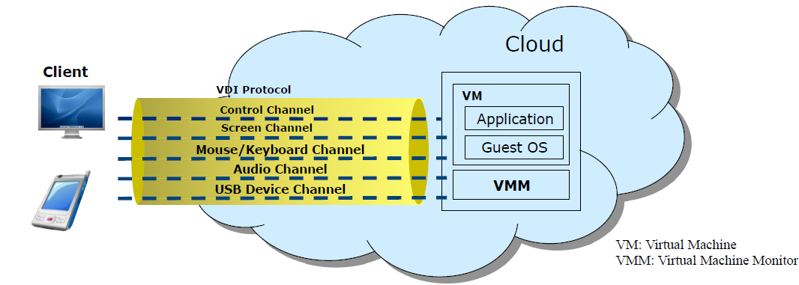
A Service
VDI is a desktop-centric service
Host users desktop environments on remote servers and/or blades, which are accessed over a network using a remote display protocol (RDP)

Slide 15
Characteristics
Every desktop user can utilize the same image
Reduce management and support costs
Generally have just one system to troubleshoot
Processing moves from individual workstations to a VDI server
Hardware costs can be more easily managed
Since almost everything will reside in the data center

Slide 16

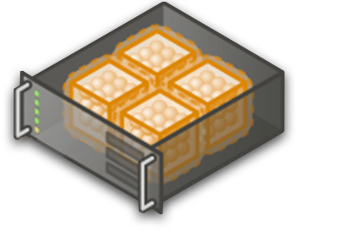

Why Centralize with VDI?
Desktop Location Independence
Hot-desking between Desktop PCs
Flexibly work from home and offsite contractor locations
Business Continuity
Data Security & Compliance
Quicker recovery from device malfunctions
Centralized data storage and backup reduces losses from stolen devices
Keeps data safe in the datacenter
Centralized tracking helps simplify the burden of regulatory compliance
Centralized Management
Reduced IT travel to user workstations for support
Improved desktop lifecycle management through quick access to centralized desktops.

Slide 17
concept
What is VDI?
Composition of VDI
Advantages and Disadvantage

Slide 18
Basic View
VDI Server
Virtual Machine hosted in a Data Center
VDI Protocol
Guest OS
VDI Client
Virtual Desktop Agent

Slide 19
Basic View
Virtual Desktop Client (VDC)
The converged end user device
VDI server
Virtual Desktop Agent (VDA)
The control software resides in a virtual machine hosted in a data center
VDI protocol
Connect client and server,
Transport the necessary control commands and I/O data
Different I/O data may be encapsulated in different virtual channel

Slide 20
VDI Components
Session
Broker
Virtualization
Platform
Client
Devices
Virtual Machine
Guest OS
Virtualization
Management
Platform
Protocol

Slide 21
Protocol
For users to connect to the virtualized OS
Handle certain features such as device and printer redirection
Decision about a protocol depends on the device end users
Example: a thin client or a remote client under a full OS
Examples:
Remote Display Protocol (RDP)
A part of CP or Vista
RDP allow users to access systems at remote locations with the ability to manipulate the system as if physically sitting at that computer terminal
Independent Computing Architecture (ICA)
A proprietary protocol for an application server system, designed by Citrix
The protocol lays down a specification for passing data between server and clients, but is not bound to any one platform.

Slide 22
Desktop Remoting Techniques
Fundamentally there are several different ways that a desktop running at one place can show up on a screen of a client at another location:
The “screen scrape” method
Screen scrape + multimedia redirection
Server graphics system virtualization
Hardware acceleration on the server and client

Slide 23
Screen-Scraping
The general idea with “screen scraping” is that whatever graphical elements are painted to the “screen” on the host are then scraped by the protocol interface and sent down to the client. This can happen in two ways:
The client can contact the server and pull a new “snapshot” of the screen from the frame buffer. This is how VNC works.
The server can continuously push its screen activity to the client. This can be at the frame buffer level, the GDI / window manager level, or a combination of both. (This is how RDP and ICA work)

Slide 24
Screen Scrape + Multimedia Redirection
A technique whereby server-side multimedia elements are sent in their native formats down to the client devices. Then the client can play the multimedia streams locally and dynamically insert them back into the proper position on the screen. This works well
If your client has the technical capability and hardware specs to render the multimedia, and
Your client has the proper codec installed so that it knows how to render the multimedia content. In effect, this means that your clients can’t be “too thin.”
This is what Citrix does in ICA with their “SpeedScreen” multimedia acceleration enhancements.
It’s also what Wyse does in RDP with their TCX enhancements.

Slide 25
Server Graphics System Virtualization
Software on the host captures all possible graphical layers (GDI, WPF, DirectX, etc.) and renders them into a remote protocol stream (like RDP) where they’re sent down to the client as fast as possible.
This will give the client an experience which is very close to local performance, regardless of the client device (even on very low-end WinCE and Linux clients).
GPU capabilities must exist on the server side where the rendering is taking place.
This is fine if you plug a physical graphics card into physical hardware running a physical OS.
In a VDI scenario, your hypervisor must be able to virtualize the GPU just like any other piece of hardware. This means that the Windows desktop OS running inside the VM be able to detect the “virtual” GPU so that it can enable all of it’s cool graphical features.
This is what Calista Technologies does today
Full desktop-like remote experience to any RDP client, even low-end ones, over the regular RDP protocol.

Slide 26
Hardware Acceleration on Server/Client
Screen and video content is captured on the host via a special chipset and sent across the network in a proprietary way to a client device with a matching special chipset.
This is what Teradici does. Today their solution works with physical blades (with their special TERA chips) and their clients (also with TERA chips.

Slide 27
Session Broker
The session broker is responsible for
Distribute sessions from clients to VMs
Redirect disconnected sessions of users back to their original VMs.
Example: Windows Server 2008 R2, XenDesktop (for Microsoft VDI), and VMware View Manager
Session
Broker
Client
VM
Client
. . .
VM
. . .
Client
VM

Slide 28
Virtualization platform
A platform hosts VMs with the client operating systems
This platform must have the capacity to host enough VMs for all concurrently connected users
Virtual Machine
Guest OS
Virtual Machine
Guest OS
Virtual Machine
Guest OS
Virtualization Platform

Slide 29
Virtual Management Platform
Virtual management platform is a platform that
Manage the servers
Provision VMs quickly and efficiently
Use templates and libraries of disk images to provision the client OS in VMs.
It ensures there is always a pool of VMs available for new connections.
Two other functions
Application virtualization
Profile and data redirection

Slide 30
Application Virtualization
Application virtualization is software technology that encapsulates application software from the underlying operating system on which it is executed.
Application virtualization is layered on top of other virtualization technologies, such as storage virtualization or machine virtualization to allow computing resources to be distributed dynamically in real time.
Application virtualization enables fast availability of applications to the virtual client OS.
Solutions for application virtualization
Microsoft Application Virtualization
For example, Windows 7 provides Windows XP Mode that enables older Windows XP application to run unmodified on Windows 7.
VMware Thin App

Slide 31
Profile and Data Redirection
It is important to maintain customization and configuration done by users between connections
Users would customize their environments
Profile and data redirection ensure that
If users switch between VMs, they have a consistent environment
If any data the user stores, including folders such as documents, is stored on a server

Slide 32
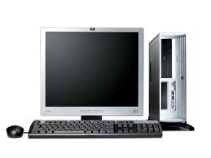
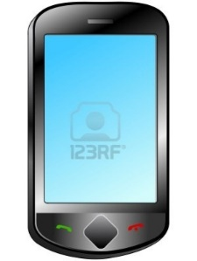
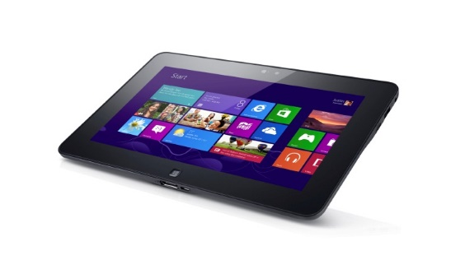
Client Devices
Client devices are the point of access
It could be
Thin clients
Clients running software on OS
Such as Windows, Linux, or others supported by the VDI solution

Slide 33
Concept
What is VDI?
Composition of VDI
Advantages and Disadvantage

Slide 34
Advantages
Improved utilization
Efficient use of CPU and memory resources
Improved availability
Reduced desktop downtime
Improved manageability
Patches and upgrades performed in data center
Centralized management reduces operational expenses
Improved security
Data and applications reside in secure data centers
Rapid Client Deployment
New users can be up and running quickly

Slide 35
Disadvantages
Need a unique image for each user who requires a different set of applications
Require a major investment in server hardware, and possibly in storage and network infrastructure
This might no be feasible for some smaller businesses
Administrators need to learn the VDI software’s capabilities and limitations
Server-side problems can affect multiple users--everyone using that server or that image.
It’s a good to set up redundant servers as a failsafe

Slide 36
Agenda
Overview
Virtual Desktop Infrastructure
Concept
Challenge
Case Study
VMware VDI
Citrix XenDesktop
Ulteo OVD

Slide 37
Challenges for VDI
Challenges
Interoperability
Ecosystem
Mobile access

Slide 38
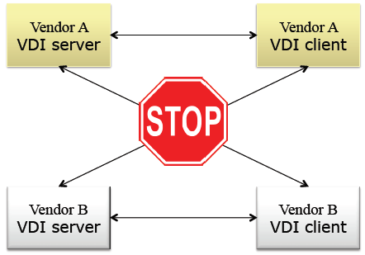
Interoperability
Although current VDI are aiming the same goal, they are defined by different companies using different methodologies.
So ……

Slide 39
Ecosystem
Each layer have tight-coupling relationship
They cannot move forward independently
Main problem for less interoperability.
VDI server
VDI Protocol
VDI Client

Slide 40
Mobile Access
Streaming application in the best current systems consuming extra 8x bandwidth compared to original bitrate
Service continuity issue
Switching over different access networks and different devices
Duplicate sign-on issue
Mobile user will be authenticated at least twice (one by the network, and another by VDI server)

Slide 41
Agenda
Overview
Virtual Desktop Infrastructure
Concept
Challenge
Case Study
VMware VDI
Citrix XenDesktop
Ulteo OVD

Slide 42
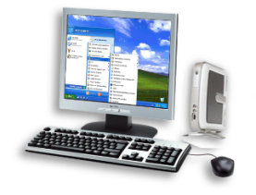
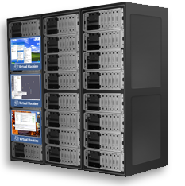
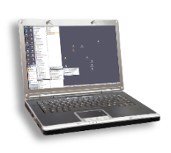
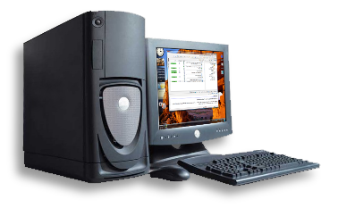
VMware VDI
An end-to-end desktop virtualization solution
Use Vmware’s proven virtualization platform (VI3)
Deliver enterprise-class desktop control and manageability while providing a familiar user experience
Control and manageability in an end-to-end solution
Familiar end-user experience
Rapid desktop deployments
Enterprise-class scalability, management and reliability
Tight integration with VMware VI3 – proven virtualization platform
Notes:
VMware Virtual Desktop Infrastructure (VDI) delivers an end-to-end desktop virtualization solution that enables organizations to centralize desktops and improve management and control using VMware’s proven virtualization platform (VI3). Individual end users benefit from the ability to access their familiar corporate desktop from any location
We’re going to walk you through the components of VDI and then discuss how your organization can benefit from VMware VDI.

Slide 43
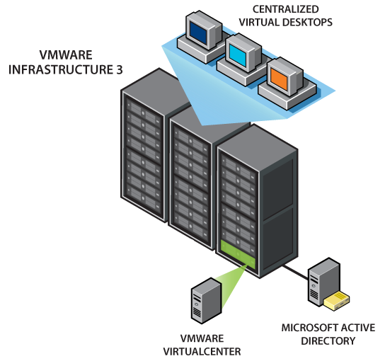
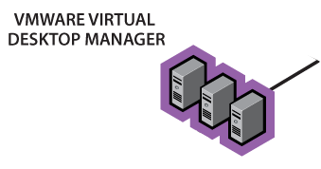
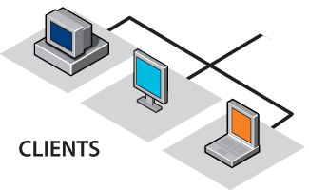
VMware VDI Solution
Notes:
VMware VDI is an end-to-end solution for any company, large or small, with these components:
VMware Infrastructure 3: The VMware VDI solution leverages proven VMware ESX and Virtual Center technology to consolidate desktop environments on to servers in the data center. [Click]
VMware Virtual Desktop Manager (VDM): Administrators run VMware’s enterprise-class connection broker for connecting remote clients to centralized desktops and managing virtual desktop environments. [Click]
Clients: Users can log into their centralized virtual desktop images from a Web browser or by using the VMware VDI Windows-native client. [Click]
Microsoft Active Directory is required to run the VMware Virtual Desktop Manager software. VMware VDM is completely integrated with Active Directory. Users are able to authenticate to VMware VDM using the same credentials used to logon to a physical PC in the corporate domain.
VMware VDM is designed for enterprise deployment. The service can be scaled horizontally to accommodate large numbers of users and to provide high availability in the case of a failure. VMware VDM can run inside a virtual machine and take full advantage of VMHA.

Slide 44
VMware Infrastructure 3 Integration
Manage desktops & servers on a single platform
No retraining: similar administrative experience across desktops and servers
End-to-end single vendor solution: common management, service and support
Bring powerful data center capabilities to the desktop:
VI3 Business Continuity (HA & DRS)
Simplify backups and disaster recovery
No single point of failure:
Synchronized VDI servers
Support for industry std server load balancing
Runs desktops on proven virtualization platform (VI3)
Notes:
VMware VDI leverages the market’s proven virtualization platform, VMware Infrastructure 3 (VI3). The VMware Virtual Desktop Manager (VDM) software is tightly integrated with VI3 to make management between servers and desktops seamless. There’s no need to retrain IT staff, since VMware VDI has the VI3 look and feel for consistent administration across desktops and servers in the data center. The support for the entire solution comes from a single vendor: VMware.
With this end-to-end solution from VMware, companies can apply powerful server tools traditionally reserved for the data center servers to their desktop infrastructures. Disaster recovery – previously not a possibility for desktops - now can be configured using VMware VDI because the desktops are centralized and can leverage shared storage technology. The centralized desktop images can easily be moved from server to server because they are encapsulated into hardware independent virtual machines.
Additionally, organizations can offer desktops a heightened level of business continuity, making use of VMware HA and DRS capabilities. IT can dynamically allocate desktop resources automatically using VI3 DRS. Running desktop VMs can be moved between servers without disrupting end-user activity. IT can overprovision desktop resources such as CPU and memory to optimize end user performance.
No single point of failure: IT can install fully synchronized VDM servers and leverage VI3’s support for industry standard server load balancing. Virtual Desktop Manager components are designed to run independently across multiple servers for additional reliability.

Slide 45
VMware Virtual Desktop Manager
Enterprise-class connection broker, connects users to their desktops via RDP
Web-based administrative interface
Automatically assigns desktops
Performs automatic desktop provisioning as needed
Designed for small to enterprise organizations
Tightly integrated with VMware Infrastructure 3 for high availability, security & scalability
Multiple VDM servers can support thousands of users
Enterprise-class Virtual Desktop Management Server
Notes:
VMware VDM is an enterprise-class virtual desktop management server. It is a key component of VDI because it manages the connections between the remote clients and their centralized desktops. We will spend some time in this presentation, covering the functionality of VMware VDM.
First it’s designed for organizations large and small. Because it’s so tightly integrated with VI3, it has been designed to work in large scale deployments and to make use of VI3’s key features such as HA, DRS, backup, etc. Organizations can deploy a fault tolerant desktop infrastructure using VMware VDM’s robust technology for connection redundancy and reliability.
Additionally, VI3 enables you to provide the same level of service to your desktops that you demand for your servers because desktops reside in your data center and can be backed up reliably. Organizations can keep desktops running even when server hardware goes down, and recover quickly from unplanned outages. They can also balance desktop computing resources automatically as user needs and application loads change over time.

Slide 46
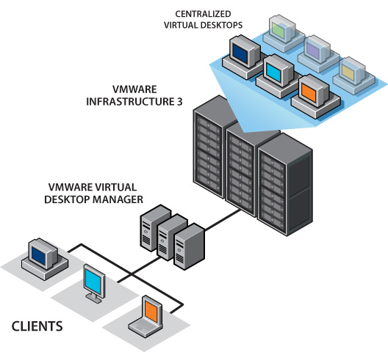
VMware VDM: Individual Desktops
Desktop virtual machines were created specifically for each user.
User is manually associated with a virtual desktop through VDM Administrator.
User is connected to same desktop on subsequent connections
Notes:
Flexible Provisioning: Deploy individual desktops for each user or create persistent and non-persistent desktop pools
Here we’re going to cover the ability to assign individual desktops to each end user. There is a static 1-to-1 relationship between user and their virtual desktop.

Slide 47
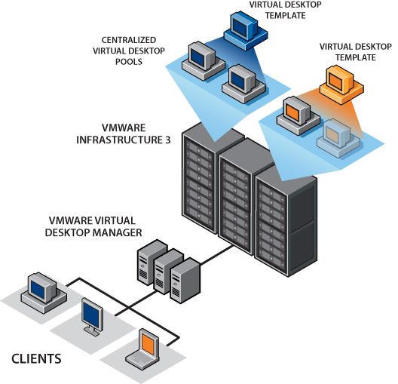
VMware VDM: Non-Persistent Pools
Individual isolated desktops returned to pool after each use
Reverts to pre-determined state for future use
Efficient way to populate & provision desktops to end users
Common template used to create all desktops
Notes:
With non-persistent pools, the desktop allocation is to any desktop in pool. The desktop is returned to pool for re-allocation at logoff. This capability is particularly important to organizations with transactional workers in cases such as call centers. The users can work with a standard desktop template. IT can more efficiently manage the number of desktops needed for a given pool.

Slide 48
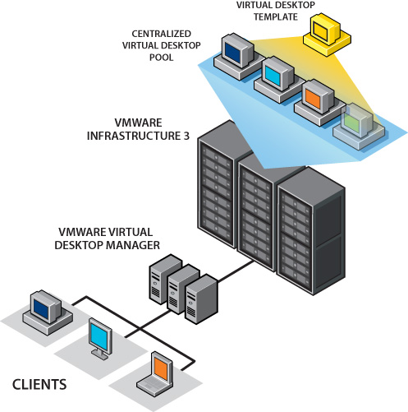
VMware VDM: Persistent Pools
Individual isolated desktops assigned to user on first log-in
Desktop remains associated with the user on subsequent logins
Efficient way to populate & provision desktops to end users
Common template used to create all desktops
Notes:
With Persistent Pools, the desktop allocation is to any desktop in pool. A dedicated desktop is provided for subsequent connections. This case is often useful to organizations that want to ensure all desktops users work from a standard corporate template when their VDI desktop is first assigned. This capability helps organizations deploy VDI rapidly and ensures consistency across desktop templates from the beginning. Yet, end users get to keep their desktop from that point forward.

Slide 49
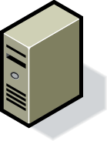
VMware VDM Security
Full integration with Microsoft Active Directory (AD):
User credentials authenticated against AD;
VDM Connection Server maintains authenticated session for each user;
‘Single sign-on’ (SSO) to virtual desktops
Optional SSL encapsulation & tunneling
Optional two-factor authentication via RSA SecurID®
Event logs
Notes:
VMware VDM 2 is tightly integrated with Active Directory and AD authentication is a pre-requisite for VDM.
Typically customer already maintain users in the Active Directory. VMware VDM references these user accounts instead of relying on an internal directory or database of users. There are many benefits of this approach:
VMware VDM supports authentication against complex multi domain configurations. Many customers have user accounts in different domains and use domain trusts to authorize access to resources in the Windows infrastructure. VMware VDM supports these sophisticated configurations by default.
User management processes do not have to be disrupted by implementing VMware VDM. These include creating user accounts, resetting passwords and changing NT permissions for users to groups. For example, if the process for resetting a user password is that the user calls the helpdesk, this can continue without having to retrain the helpdesk administrators.
User account policies, such as password complexity or expiration are also retained. Users in VMware VDM can reuse any existing group policy in the domain.
By referencing domain accounts directly, VMware VDM does not need to use third-party or inbuilt replication systems. This means there is no risk of data becoming out of sync and removes any computational overhead of user-data replication.
It is possible to configure strong two-factor authentication using SecurID, in addition to AD authentication. Two-factor authentication is often a requirement for users who access the VDI environment from an un-trusted client or over an un-trusted network.

Slide 50
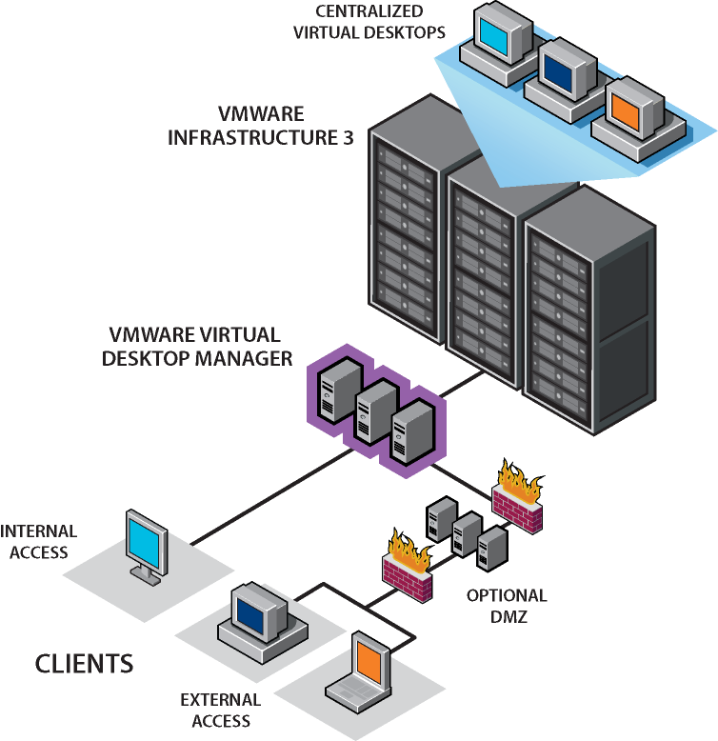
VMware VDM Security Server
SSL VPN used to secure connections between clients and VMware VDM connection broker
Optionally runs within the DMZ (demilitarized zone) for remote access users
Fully encrypted connections
Grow security servers for scalability of secure connections
Outside the firewall (remote access connections)
Notes:
VMware VDM encrypts the connection data stream by default. An SSL connection is established between the VDM Client and VDM Connection Server over HTTPs. The desktop connection is tunneled through this connection to give maximum security to data.
If the VDM Security Server is deployed in a DMZ the SSL connection is established between VDM Client and VDM Security Server.
It is possible ‘bypass’ the SSL tunnel and establish a direct RDP connection. This is typically not recommended.

Slide 51
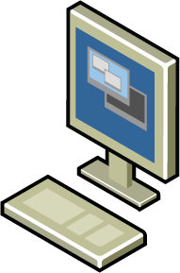
VMware VDI Client Access
Native Windows Client
Provides extended capabilities (e.g. USB device support on Windows XP & Vista)
Thin-Client Support
Thin clients based on Linux and XPe
WYSE ThinOS models
Browser Access
Windows, Linux & Mac
Notes:
The VDM Client is an application used to connect clients to VDM Connection server and to virtual desktops. The user enters the URL of the VDM Connection Server and their AD credentials into the VDM Client.
Alternatively, end users may use a browser to access their VDI desktop.
VMware VDI can be enhanced using thin clients. Thin clients can reduce the TCO of a VMware VDI deployment because the ongoing support and maintenance costs of thin clients is generally less than that of traditional PCs. VMware VDM 2 support XPe and Linux clients, which provides support for many of the thin clients on the market. The WYSE S10 and V10L devices are also supported.

Slide 52
What Distinguishes VMware VDI?
Familiar End-User Experience
Run applications with no modifications. Virtual desktop is unchanged.
Leverage existing desktop mgmt tools
Support for USB devices through RDP extensions (e.g. local printing, storage, etc.)
Support multi-monitors in “stretch mode”
“Our users love their hosted desktops. One user was totally upset and crying because she thought she had lost her documents. She couldn’t believe it when the terminal came back up and everything was just how she had left it.”
David Siles CTO Kane County Government (Illinois)
Making the move to virtual desktops as seamless as possible
Notes:
Let us not forget the end user. End users want a familiar PC experience: they want their complete desktop. They won’t be satisfied with a solution that doesn’t allow them to perform installations or configure their PC the way they like it.
VMware customers have found the transition to a VDI solution to be smooth because end users use the same (virtual) desktop, just running over a remote connection. VMware VDI coexists within corporate environments seamlessly. Organizations can run off-the-shelf, legacy or custom apps with no modifications as well as leverage existing desktop management tools.
VMware VDI includes support for USB devices on the local client such as local printers, storage, PDAs, etc.
And unique to VDI compared to other shared application technologies (e.g. terminal services), VDI desktops are complete isolated desktops. If one desktop goes down, the other users aren’t affected. VDI provides the flexibility of accessing the centralized desktop image from any device anywhere.

Slide 53
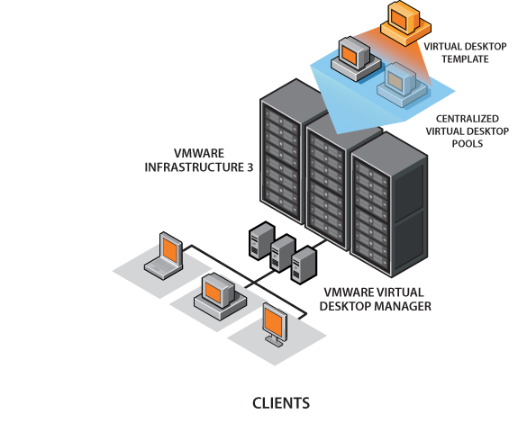
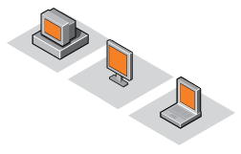
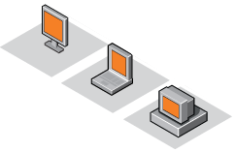
What Distinguishes VMware VDI?
Rapid Deployment
VMware Infrastructure templates can be used to replicate 1000s of desktops quickly
Automatic desktop provisioning with VDI pooling capabilities
Rapid redeployments of virtual images throughout desktop lifecycle
Changing, patching, restarting images improved when centralized & virtualized
Notes:
Deploy desktops in minutes instead of weeks through automated desktop provisioning. Standardize the deployment process by maintaining a library of pre-built desktop images in VMware VirtualCenter that can be called on quickly when a new office or group of users are needed.

Slide 54
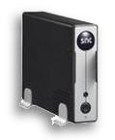

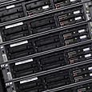
How Customers Use VMware VDI
Desktop PC Replacement
Replace traditional PCs with thin clients, repurposed PCs or less costly desktop hardware. Address short desktop lifecycles. Simplify moves, adds & changes (MACs) because the desktop images are administered in corporate data center.
Transactional Office Workers with Security Needs
Secure all sensitive personal records or intellectual property running on laptops in host country data center. Control access to centralized desktop images through Microsoft AD. Provide complete desktop isolation. Ensure all sessions are fully encrypted using VMware VDI’s optional Security Server.
Disaster Recovery & Business Continuity
Eliminate unplanned desktop downtime through VMware Infrastructure 3 DRS and HA capabilities. Simplify backup and desktop disaster recovery because desktops are located in corporate data center and can leverage shared storage technology.
Notes:
Centralized Desktop Management:
Use VMware VDI to replace traditional PCs with virtual desktops that run on servers in the data center, making them easier to control and manage. Administrators can provision new virtual desktops in minutes, and give end-users their own complete, unmodified desktop environments, eliminating the need for retraining and application sharing.
Transactional User Management:
VMware VDI is ideal for delivering cost-effective desktop services to fixed-function workers at branch offices, call centers and other locations. Controlling access to confidential data is easier because all virtual desktops and their data can be stored inside the firewall.
Disaster Recovery & Business Continuity:
VMware VDI extends the proven power of VMware Infrastructure 3 to the desktop, and VMware VDI customers enjoy the reliability, data protection and disaster recovery capabilities that have traditionally been available only for server applications. Features such as automated failover ensure high availability for virtual desktops, and you can leverage shared storage to back up your desktops, just as you would with server data. Site-wide disaster recovery mechanisms ensure rapid restoration of service after an unplanned outage—without the need for duplicate hardware.

Slide 55

VMware VDI: Summary
Centralized Desktop Management & Control
Desktops moves, adds & changes (MACs) are easier from a single location. Support personnel no longer needed on location
Maintain Desktops in Secure Corporate Datacenter
VMware VDI desktops are isolated from one another
Familiar End-User Experience
A complete isolated desktop that is unchanged, simply running inside a virtual machine. No retraining. No custom modifications.
VMware Infrastructure 3 Scalability & Reliability
Brings powerful VI3 capabilities to the desktop
Single vendor solution
Notes:
VMware VDI is providing organizations with unprecedented control and manageability over their desktops. And most importantly the end users are retaining the freedom they need of running a complete desktop.
All from the leader in virtualization technology, VMware, running in 20,000 companies worldwide.

Slide 56
Agenda
Overview
Virtual Desktop Infrastructure
Concept
Challenge
Case Study
VMware VDI
Citrix XenDesktop
Ulteo OVD

Slide 57
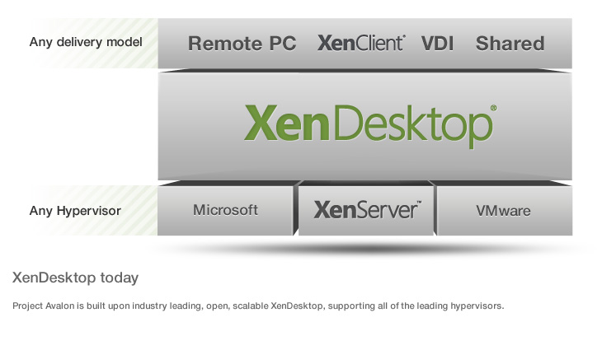
Composition

Slide 58
Features
Supports any device, anywhere
Deliver high user experience, even in 3D
Deploy virtual desktops and apps for any use case
Any Windows, Web or SaaS Applications
Transforms IT with open, scalable and proven technology
Single-instance management
Data security and access control

Slide 59
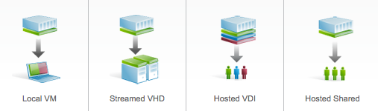
Different Types of Virtual Desktops
Local VM
Streamed VHD
Hosted VDI
Hosted Shared

Slide 60

Local VM
Local VM desktops extend the benefits of centralized, single-instance management to mobile workers that need to use their laptops offline.
When they are able to connect to a suitable network, changes to the OS, apps and user data are automatically synchronized with the datacenter.

Slide 61

Streamed VHD
Streamed VHDs leverage the local processing power of rich clients, while providing centralized single-image management of the desktop.
This approach offers an easy, low-cost way for customers to get started with desktop virtualization by leveraging existing PC resources and keeping datacenter overhead to a minimum.
It can also be ideal for government and university labs that use diskless PCs for maximum data security.

Slide 62

Hosted VDI
A Windows 7/XP desktop running as a virtual machine where a single user connects remotely. One user’s desktop is not impacted by another user’s desktop configurations.
Hosted VDI desktops offer a personalized Windows desktop experience, typically needed by office workers, which can be securely delivered over any network to any device.
This option combines the benefits of central management with full user personalization, and can generally support up to 150 desktops per server.

Slide 63

Hosted Shared
Users get a desktop interface, which can look like Windows 7. However, that desktop is actually being shared by every user on the server.
Hosted Shared desktops provide a locked down, streamlined and standardized environment with a core set of applications, ideally suited for task workers where personalization is not needed — or allowed.
Support up to 500 users on a single server, this model offers a significant cost savings over any other virtual desktop technology.

Slide 64
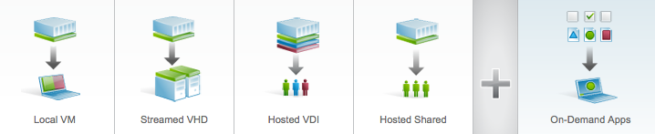
On-Demand Apps
Allows any Windows application to be centralized and managed in the datacenter, hosted either on multi-user terminal servers or virtual machines, and instantly delivered as a service to physical and virtual desktops.

Slide 65
Typical Desktop Deployment (Revisit)
User data & preferences
Desktop Management
Tightly
Coupled
1. procure
8. retire
Profile
Apps
2. image
7. back-up
Applications
Windows
3. secure
6. maintain
Hardware
Locally Installed
4. deploy
5. monitor
Existing methods, tools, and processes
Operating System
Notes:
Lets look at the problem so that we might be able to establish how to address them.
Typical desktop deployment involves the administrator giving the user a desktop machine. And its typically got a corporate image put onto it with customizations to the OS that the admin has specified along with the applications required for that end user.
You give it to the end user, and they develop a profile on it, basically storing data, sometimes in their profile, sometimes outside.
They may have the ability to install applications (if given the right to), and they may be modifying applications and so forth.
What happens is that whole stack (OS, apps, profile) becomes very tightly coupled together and its only resident on that local machine. It becomes very difficult to maintain a complete picture of what is on that machine from the data center.
You may be familiar with trying to implement roaming profiles….that is very challenging.
Now the desktop that you provided the user has become customized, it takes a lot longer to roll out applications because when you do the app regression testing, you now have a huge number of variables to take into consideration before you roll out that application. That becomes very time consuming and very expensive.
If you take these problems into consideration, you end up with hundreds of images and vast image complexity.
And it means high touch re-imaging whenever a user has to replace their machine and you’ve got a heavy test load.
As a side note, we think customers are going to be reevaluating the way that they look at desktops as a result of end users driving the demand for Vista. While companies aren’t rolling out Vista in the immediate future, in many cases its been pushed back a bit. That will likely be demanded by the end user community.

Slide 66
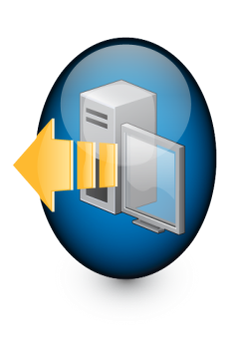
Desktop Delivery Vision
XenDesktop is a Better Way…
Profiles
Profile
Virtualized & Isolated
Apps
Windows
Hardware
Dynamically Delivered
Apps
XenDesktop
Fewest possible desktop images
Desktop image simplicity
Fewer conflicts, minimized testing
Low-touch, self-serve re-imaging
OS
Notes:
What’s Citrix’ vision for a better way to do it?
Citrix vision is to separate the OS, the applications and the user profile.
In other words, we’re talking about isolation of the OS, isolation of the applications, and isolation of the user’s profile.
If you can separate apps from OS and keep the OS pristine, you can maintain that first time user experience. Separating them and delivering them dynamically onto the desktop.
Citrix feels that if the customer can do this effectively, and we do feel we can do this with XenDesktop, you’ll have the fewest possible images, and those images will be far simpler to maintain. It will translate to a much reduced testing burden and you’ll be able to get people up and running much, much quicker.
XD will deliver this capability and the following slides will discuss how XD will do that.

Slide 67
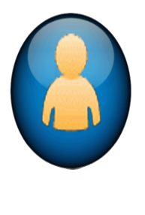
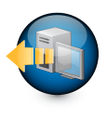

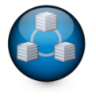

Desktop Delivery Components
Support
Brokering
Monitoring
1
2
Users request their desktop by logging in to the system
Operating Systems, Apps, and user Profiles are provisioned on demand
Profiles
Users
WAN Optimization
Secure Remote Access
Hypervisor
Apps
3
Users are delivered their desktop remotely
Blade Chassis
OS
Virtual Desktop Infrastructure
Notes:
The basic components of desktop delivery from a Citrix perspective are:
End users connecting to a brokering mechanism
That brokering mechanism then needs to prepare the desktop for delivery to the end user
That desktop could be on blades or it could be on a hypervisor
The desktop brokering mechanism needs to tell the back-end infrastructure to prepare the desktop for the end user.
Once that is prepared, (and it can be prepared beforehand to give the user a faster start-up experience), it can be delivered via a protocol out to the end user
There are other aspects of delivering the desktop, for example:
We recommend that in order to delivery it securely, that you have a secure remote access solution
If you’re delivering the desktop to branch offices or anywhere over the internet, its good to have a WAN optimization solution
Customers are going to need some way to support this desktop. When you’re supporting a virtual desktop, its not the same as supporting a physical infrastructure – so you need to take that into account.
Then you need some way of monitoring the infrastructure where the desktop is being delivered from.
Citrix is uniquely positioned to provide all of those pieces

Slide 68
Citrix XenDesktop v2 Technology Components
GoToAssist
Desktop Delivery Controller
EdgeSight
Profiles
ICA Client
WANScaler
Access Gateway
Xen, Hyper-V, VM
XenApp
Apps
Provisioning Server
Blade Chassis
OS
Virtual Desktop Infrastructure
Citrix Optimized Storage
Notes:
This next slide outlines the names of the components that enable the functionality that was just discussed on the previous slide and that will be part of the XenDesktop Platinum offering.
We’ll go through each of those components and talk about them in terms of how you implement it and how it works as a unified product.

Slide 69
 | Express | Standard | Advanced | Enterprise | Platinum
Price (per CCU) | $0 | $75 | $195 | $295 | $395
Core components Desktop Delivery Controller VM Infrastructure | ✓ | ✓ | ✓ | ✓ | ✓
Secure Remote Access |  | ✓ | ✓ | ✓ | ✓
Scalability Desktop Provisioning Resource Pooling & XenMotion |  |  | ✓ | ✓ | ✓
Desktop Delivery Services Performance Monitoring Virtual Desktop Support WAN Optimization EasyCall |  |  |  |  | ✓
Integrated App delivery (XenApp for Virtual Desktops) |  |  |  | ✓ | ✓
Notes:
The editions that are available in XenDesktop are:
Express -Test user experience of desktop virtualization - test the waters.
Standard - Desktop virtualization for a small branch office or pilot implementation; cost effective solution for virtually delivering desktops using the ICA protocol
Advanced - Desktop virtualization with existing app delivery solution; Most comparable other solutions in the marketplace.
Enterprise - Desktop virtualization with integrated app delivery
Platinum - Desktop virtualization with integrated app delivery and service level management capabilities; complete end-to-end desktop virtualization solution

Slide 70
Basic Desktop Delivery
GoToAssist
Desktop Delivery Controller
EdgeSight
Profiles
ICA Client
WANScaler
Access Gateway
Xen, Hyper-V, VM
Apps
Virtual Desktop Agent
Blade Chassis
OS
Virtual Desktop Infrastructure
Citrix Optimized Storage
Notes:
In this slide, we start to go through the components.
Starting with the basics of desktop delivery.
The components in the basics of desktop delivery, in the standard edition include:
- the controller
- the ICA client
- XenServer standard edition capabilities

Slide 71
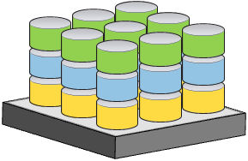
Virtual Desktop Agent and ICA Client
Installed on all Desktops (VM's or Blades)
Supports XP SP2 and Vista SP1 (32bit)
Delivers virtual desktop via ICA to any ICA client
Desktop Delivery Controller
SpeedScreen
SpeedBrowse
SmoothRoaming
Universal Print Driver
Dynamic client drive mapping (USB drives)
Multi-monitor support
Session Reliability
ClearType
etc…
ICA
Virtual Desktop Agent
Notes:
The next critical component to understand is the Virtual Desktop Agent (VDA). The Virtual desktop agent is the piece that delivers the desktop via ICA, so that there is an end-to-end ICA connection between the physical endpoint and the virtual desktop running in the data center. That piece needs to be installed on all of the virtual desktops that are going to be delivered remotely.
Citrix views this as a significant differentiator (think about comparison of ICA vs. other protocols available today). We’ve got significant advantages. And they are primarily revolve around the features that you may be familiar with in XenApp (speedscreen, speed browse, smooth roaming, universal print driver and so on.)
Many of the benefits that you associate with XenApp will increasingly become available in XenDesktop.

Slide 72
Desktop Delivery Controller
Solution
Simple to deploy and administer
Brokers and end-to-end ICA connections
Manages flexible desktop-user association:
Pooled
Assign on first use
Pre-assigned
Enables secure ticket-based connections
Supports single sign-on
Runs on Windows Server 2003 (32 & 64-bit)
Broad desktop hosting infrastructure support
Efficient use of AD for non-volatile settings:
Transactional data moved from AD to Data Store in Beta
Desktop Delivery Controller
ICA
Virtual Desktop Agent
Notes:
The Desktop Delivery Controller (DDC) is the piece that brokers the connections between the endpoint and the virtual desktop. When we built the DDC, which has nothing to do with the brokering solution that is available with XenApp (Desktop Server 1.0), we rebuilt this from scratch as a dedicated brokering solution for dynamic desktop delivery.
We started with the premise that it needs to be very simple to deploy, it needs to broker end-to-end ICA connections.
We needed it to manage a flexible user association for:
- desktops that are pooled
- desktops that are assigned
- on first use
- or preassigned to users
We wanted it to be secure – we use a similar ticketing mechanism as XenApp.
We needed it to support single sign on.
Runs on server 2003 and will on 2008 when that is available.
We wanted to make sure it supported a broad range of hosting infrastructure
We wanted to not only run on top of XenServer, we also wanted it to run on top of blades
We wanted it to have efficient use of Active Directory (AD)
For those that looked at the Tech Preview Kit, it leveraged AD extensively
We’ve decided in the Beta and GA release, to move some of the volatile data back into the data store – the problem we were having was the replication of active directory across forests is not as rapid as we needed it to be for the data we were storing in there. That is modification that customers will see in the Beta.

Slide 73
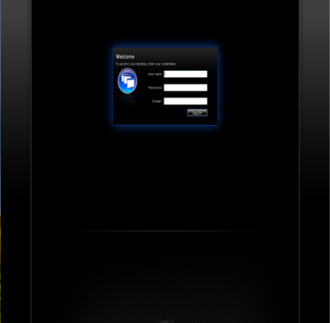
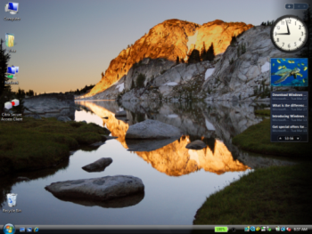
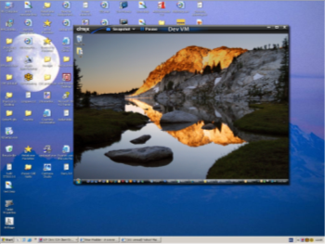
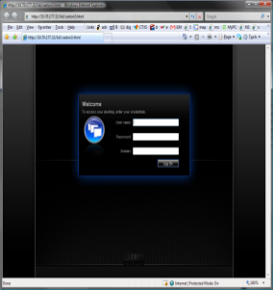
End User Experience
Access Scenarios
Desktop Appliances
login
Full-Screen
unmanaged machines
Web page
Windowed
Full-Screen
Notes:
The end user experience of connecting between the ICA client and XenDesktop is slightly different than customers may be familiar with in XenApp.
The moment you turn on the desktop appliance, the only thing you’ll see when the virtual desktop appliance is finished booting is the login page that has the user credentials.
Once credentials are entered, they will see their desktop only in full screen mode and they can’t break out of full screen mode and can’t access the local operating system on the desktop appliance.
If accessing remotely, the user will go to a webpage that looks exactly the same as they saw on the desktop appliance, its just that its in a browser window.
When they enter their credentials, they’ll get their desktop in a windowed experience, very similar to a GTMyPC experience, where it can be resized both from a scaling perspective and a resolution perspective.
It can also be delivered full screen. When done, the toolbar at the top of the window goes into autohide mode…although you’d can pin it.

Slide 74
Virtual Desktop Infrastructure
GoToAssist
Desktop Delivery Controller
EdgeSight
Profiles
ICA Client
WANScaler
Access Gateway
Xen, Hyper-V, VM
Apps
Blade Chassis
OS
Virtual Desktop Infrastructure
Citrix Optimized Storage
Notes:
The next slides go through the rest of the infrastructure, namely the virtual desktop hosting infrastructure.

Slide 75
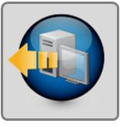
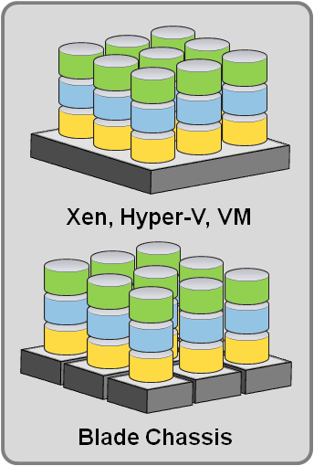
Virtual Desktop Infrastructure
Agnostic to desktop hosting infrastructure
Enable management of desktops to optimize:
Power consumption
Infrastructure utilization
Virtual Machine Support
XenServer
Hyper-V
VMware VI3
Blade PC’s
Power for specialized users
Integration to VM infrastructure
Start
Suspend
Resume
Shutdown
Traditional PC’s
Migration and remote access
SDK coming
Desktop Delivery Controller
Virtual Desktop Infrastructure
Notes:
From a virtual desktop infrastructure perspective, we wanted to have the ability to support multiple different desktop hosting infrastructures. So, customers will find that we are agnostic as related to where you put your desktop stack. We want to allow the brokering mechanism to control desktops whether those desktops are running on a VM infrastructure or not and interact with them.
In XenDesktop 2.0, we’ll have full integration for management of desktops running on virtual machines from XenServer, MS Hyper-V and Vmware VI3 (From a hosting infrastructure perspective, XenServer is obviously the VM infrastructure of choice).
We also have support for desktop blades out of the gate, but we don’t yet provide for integration to blade management infrastructure (for things like power management), but that will come over time.
Integration that we have to the various vm infrastructures will support start, suspend, resume, shutdown…all the things you’d expect.
There is an SDK coming that will enable you to customize the interaction between the broker and the hosting infrastructure more extensively.
We do support traditional PCs…for us there is no difference between traditional PCs and a blade.
Out of the gate, we won’t be supporting any capabilities around migration or movement from physical to virtual device, but there is more to come over the coming months in this area.

Slide 76
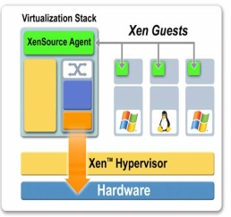
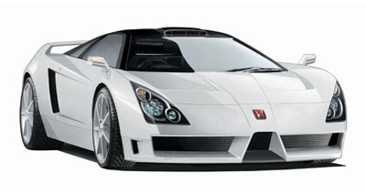
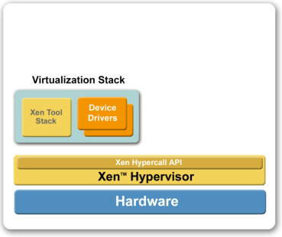



XenServer
Fast:
Para-virtualization sheds the ‘middle man’
Secure:
Thin hypervisor drastically reduces attack surface
Low maintenance:
No drivers and thin means minimal patching – keeps workload running
XenDesktop Specific Integration:
XenDesktop Specific Templates
Preboot eXecution Environment VMs (<500Kb in size)
Near Bare Metal Performance
Resource Pools
Native 64 bit hypervisor
Next Generation Management Architecture
XenMotion: Live Relocation
Clustered Management Layer
Notes:
We’d argue that XenServer is the best performing hypervisor for this purpose/workload as well as any other purpose based on its paravirtualization capabilities.
Its secure, it has a vastly reduced attack surface because its so thin. That also provides for a low maintenance as a result of this thinness.
It has and will increasingly have deeper XenDesktop-specific integration, for example there will be XenDesktop templates when you create vm’s. One of those templates will be the PXE boot environment to support Provisioning Server capability in XenDesktop.

Slide 77
OS, App & Profile Management
GoToAssist
Desktop Delivery Controller
EdgeSight
Profiles
ICA Client
WANScaler
Access Gateway
Xen, Hyper-V, VM
XenApp
Apps
Provisioning Server
Blade Chassis
OS
Virtual Desktop Infrastructure
Citrix Optimized Storage
Notes:
Going back to the infrastructure, on the right hand side you’ll see that we separated profiles, os and applications.
We separate profiles and deliver them as a single image from Provisioning Server.
We separate applications from the image and deliver them either using ICA via XenApp or using streaming from XenApp.
And profiles, we’ll talk about in a coming slide.

Slide 78
OS, App & Profile Management
VDI without XenDesktop
Single image for every desktop
Desktops managed individually
Same problems, in a new location
VDI with XenDesktop
Single OS image to store & maintain
Apps not installed, stored as single image, delivered on demand and maintained centrally
Managed Profiles
1:1
Hypervisor
Network Storage
Xen, Hyper-V, VM
Network Storage
Notes:
As mentioned earlier, you want to separate applications, OS and profiles and deliver them dynamically. The problem with not taking this approach is that you ultimately have a single image for every user. This is going to dramatically increase the number of images that you have to manage and store. The other problem is that you’ve just moved the problem into the data center. Its closer to manage, but each image has to managed individually, which is problematic.
You really have the same problems as with traditional desktop deployment, but in a different location.
If you take the Citrix approach, what happens is that you have a single OS to image or at least a vastly reduced # of images (we’d like it to be one).
You deliver the applications from XenApp (either from ICA or streamed) so that they are not installed. They’re stored as a single image on your storage instead of being resident through out all of OS’s on the individual virtual desktops.
And you store the application as a single image.
So you can see, that you have a vastly reduced storage requirement, but you still deliver the user with the same experience. This is much more cost effective and much easier to manage.
A few notes on profile management:
The way that we recommend doing profile management is through a number of partners such as Sepago, AppSense, Tricerat and RES.
They are going to help you implement profiles so that they can effectively be managed for the users that connect to XD.

Slide 79
How to Implement XenDesktop v2
GoToAssist
Desktop Delivery Controller
EdgeSight
Profiles
ICA Client
WANScaler
Access Gateway
Xen, Hyper-V, VM
XenApp
Apps
Provisioning Server
Blade Chassis
OS
Virtual Desktop Infrastructure
Citrix Optimized Storage
Notes:
From an implementation perspective, the first thing that you need to implement/install is the desktop delivery controller.
They key things to be covered here are the desktop delivery controller, the hypervisor infrastructure, the client and what you do in the back end for profiles, apps and operating systems.

Slide 80
How to Implement XenDesktop v2
Desktop Delivery Controller
AD OU
Login Page
Licensing
Data Store
Domain Controller
Secured Web Services
Profiles
ICA Client
Xen, Hyper-V, VM
Setup Tool
Apps
Golden Image:
PV Tools
Virtual Desktop Agent
ICA & Streaming Client
VDisk
OS
Notes:
The XenDesktop environment would look as shown on this slide:
The Desktop Delivery Controller (DDC) is actually the brokering mechanism. It incorporates the login page. This is the thing you’ll be familiar with from XenApp as Web Interface. Although, its modified for XenDesktop to only have an authentication entry gateway.
As part of the DDC, you also implement the license server and the data store. In that environment, you’ll also need a domain controller. In the domain controller, we don’t extend the schema at all, but the admin for the DDC is going to have to ask for her own Organizational Unit (OU) on the domain controller. So, that’s a discussion that the DDC administrator will have with the person that manages the active directory.
Then we recommend that customers prepare a golden image to work from. So preparation of the golden image is to create an image that is compatible with Provisioning Server for operation on the Xen hypervisor. Once an image has been created that is compatible with Provisioning Server, make it into a template and then make it available for Provisioning Server to deliver into the Xen environment. Then, once you’ve created the vDisk, that’s the way that you’ll be able to deliver the operating systems on demand to the users as you spin up more and more virtual desktops.
What we’ve done to integrate the DDC, the Xen hypervisor and the Provisioning Server components that we’re introducing with XenDesktop is the creation of a Setup Tool. More on the Setup Tool on the next slide.
The last piece is to install the ICA client. If you’re using desktop appliances, they will be preconfigured for that. If the users are connecting from remote location then they’ll of course have to install the ICA client.
The client is updated with XenDesktop. There will be a 10.200 client that will be associated with the delivery of XD which incorporates the windowed viewer experience as well as the login experience shown before on an earlier slide.

Slide 81
How XenDesktop v2 Works
Desktop Delivery Controller
AD OU
request
license
Login Page
Licensing
Data Store
Domain Controller
policies
find desktop
sign & launch
validate
ICA
prepare
resume
Profiles
ICA Client
Xen, Hyper-V, VM
Apps
Golden Image:
PV Tools
Virtual Desktop Agent
ICA & Streaming Client
VDisk
OS
Notes:
How XD works is essentially quite similar to how end users connect to XenApp.
The end user will get to the landing page shown earlier and enter their credentials at which point, the request for the desktop are sent to the delivery controller.
The delivery controller then works out which desktop is appropriate for the end user. It establishes that from the data store.
What it does then is to set up the environment for the end user to connect to. If it’s a provisioned desktop (the way that we’ve recommended that you implement the product) and the environment is not already spun up, it will initiate a boot of the virtual machine and the operating system will be delivered from Provisioning Server.
In the setup for XD, you have an alternative option to eliminate the startup delay for the end user. You can do this by configuring that for particular desktop groups, you want to specify an idle pool. From marketing perspective, this will be known as an ‘instant on’ capability.
What that really means is that on the backend, we can have the virtual machines pre-launched such that when the user connects, they get an instant on experience.
The way that this is configured on the desktop delivery controller is for each group, you specify the range of time you want a specific number of idle machines available. For example you can say that from 9am to 5pm you want 15 machines spun up and ready for use, where as outside of working hours, you bring it down to 2 or 3. Then the Desktop delivery controller will manage your infrastructure accordingly so that the user gets an instant on experience.
That integration is only available for virtual machines at launch, but an SDK will be coming later on for customers to modify that for support with blades. We’re going to introduce blade support as we move forward in upcoming releases.
Once the VM has been started, we send a preparation for connection to the VDA (the thing that delivers the ICA experience from the virtual desktop). The VDA resides on the virtual desktop. Its not always waiting for a connection.
From a security perspective, we wanted to be able to control when you’d be able to connect to those virtual machines. Not until an end user authenticates and the desktop delivery controller sends a preparation message to the VDA that you can connect to a virtual machine using ICA. This is a nice security feature that we’ve implemented to control who can access the virtual desktop and when.
What happens then is that the ICA client connects to the VDA. What's important about this is that clearly unlike the first release of DS v1, this is a direct ICA connection to whatever the virtual desktop is running on, virtual machine or the blade. This is a direct ICA experience just like customers are used to with XenApp.
What we do then is that we validate through examining a ticket that was previously created, whether that is the right user that is supposed to be connecting to the virtual machine and if that is not correct, we drop the connection.
We consume a license (XenDesktop will be licensed on a CCU basis, just like XenApp).
Then we implement policies for the way that that ICA connection is delivered. This is the point at which we would in XenApp say which apps are available. In XenDesktop this is the point at which we control policies like the ‘end user is able to map drives from the local machine’.
We have full support for the policies that customers are familiar with in XenApp as well as the SmartAccess capabilities of the AG product line. That is when those policies would be implemented.
That is essentially how XD works.

Slide 82
Agenda
Overview
Virtual Desktop Infrastructure
Concept
Challenge
Case Study
VMware VDI
Citrix XenDesktop
Ulteo OVD

Slide 83
Ulteo Open Virtual Desktop (OVD)
Ulteo Open Virtual Desktop is an installable Open Source virtual desktop and application delivery solution for corporations.
It allows IT departments to deliver desktops and applications easily and at a lower cost than other solutions.
It works in both a Windows and Linux environment.

Slide 84
Infrastructure Overview and Vision
Ulteo OVD is all about mixing various applications sources into a consistent stream that can be delivered to users, depending on their needs.
It's also been designed to be integrated in heterogeneous environments and inter-operate with various technologies.

Slide 85
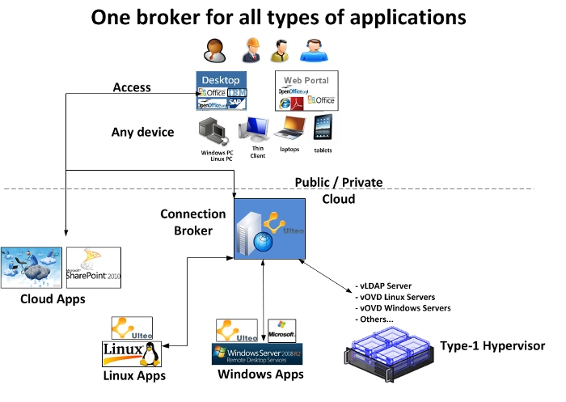
Infrastructure Overview and Vision

Slide 86
Key Benefits for IT
Ease of use, ease of deployment and management:
Clients can be either a Java enabled web browser or a dedicated software client.
Interoperability:
Full integration with existing infrastructures including Microsoft environments (Windows authentication, Windows applications, Active Directory, File server).
Customizable:
Ulteo is using Open Source software. Ulteo source code is covered by GPL v2 software licensing terms.
Lower cost than any comparable product
Secure, reliable, scalable

Slide 87
Key Benefits for End-users
Easy to use:
Applications are delivered as a complete desktop or displayed seamlessly and integrated to the user's desktop.
Access is possible from a simple web browser, a web portal or accessed from a dedicated client software.
Ulteo OVD provides its own web portal as a demo portal, but corporations are free to integrate Ulteo services into their own web portals.
Extensive application portfolio:
Access any Linux and/or Windows applications
User friendly:
Browser based interface

Slide 88
Core Architectures
Desktop mode
Application/portal mode
Application mode or Desktop mode with WAN access through OVD Gateway

Slide 89
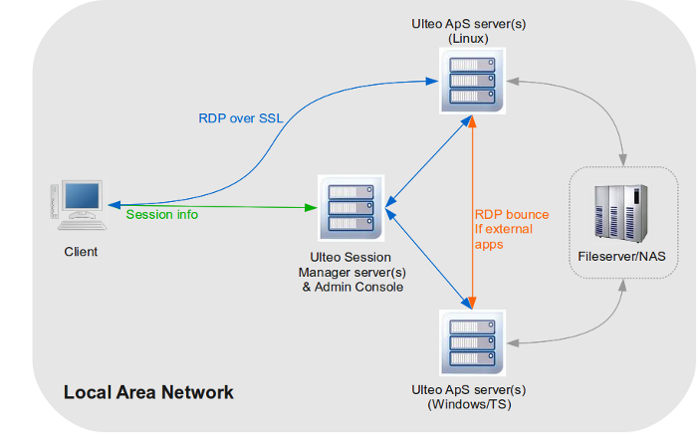
Desktop Mode
Windows or Linux Desktop with a mix of remote Windows and/or Linux applications

Slide 90
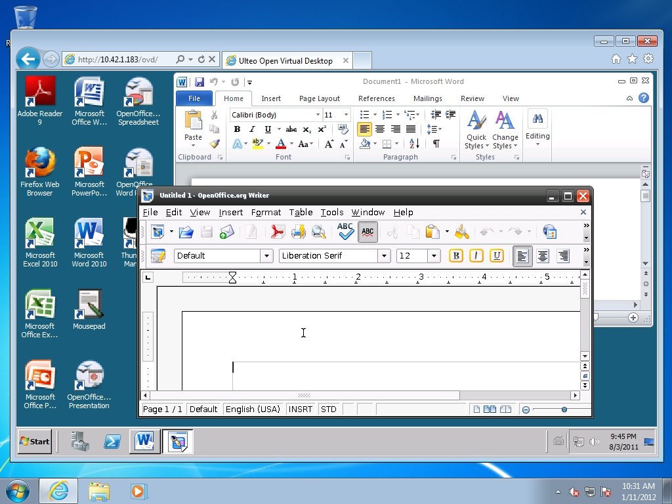
Desktop Mode Example
Windows & Linux apps on a Windows desktop, in the web browser

Slide 91
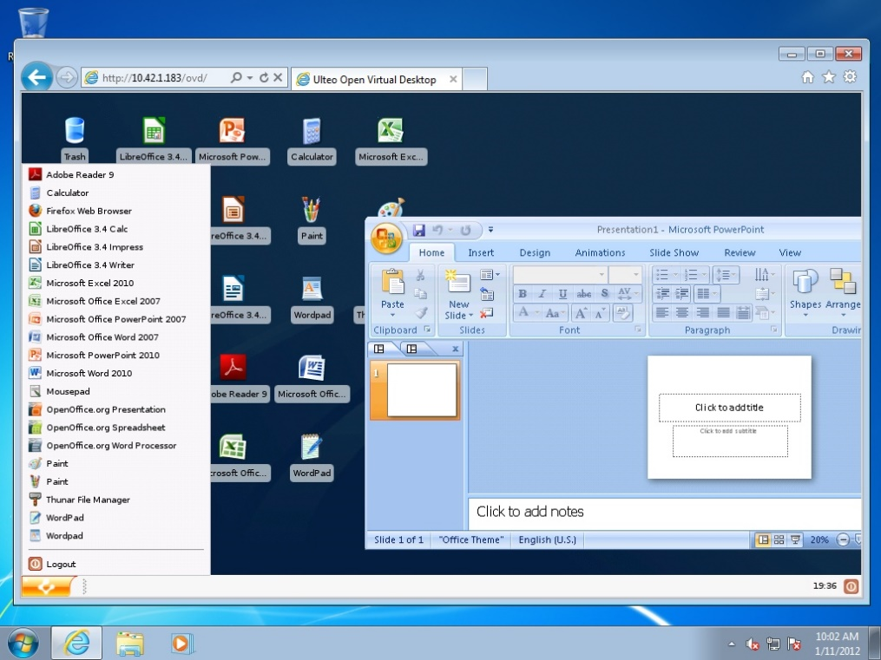
Desktop Mode Example
Windows & Linux apps on a Linux desktop, in the web browser

Slide 92
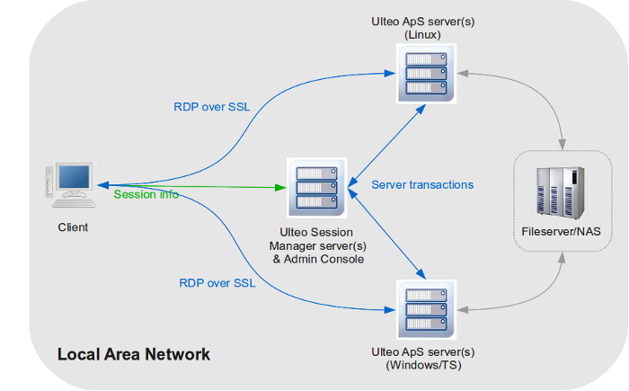
Application/Portal Mode
Application Portal, to run remote Windows and/or Linux applications from web links

Slide 93
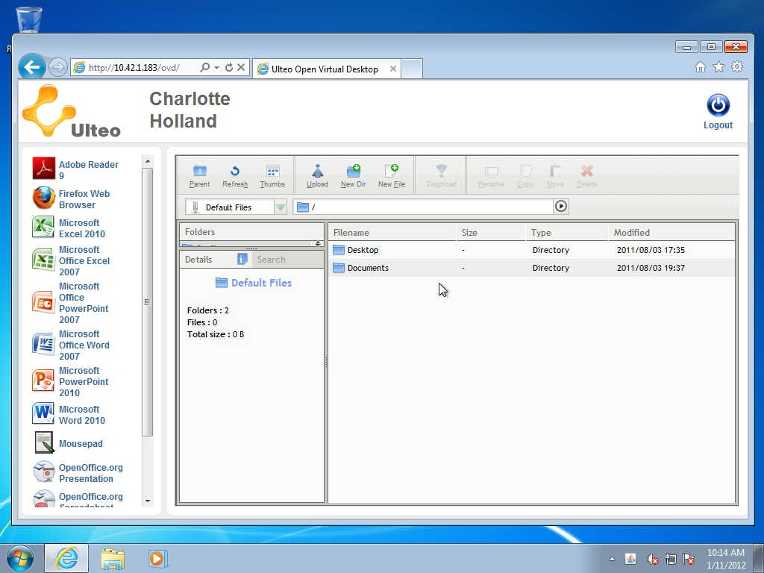
Application/Portal Mode Example
Portal mode, with embedded file manager

Slide 94
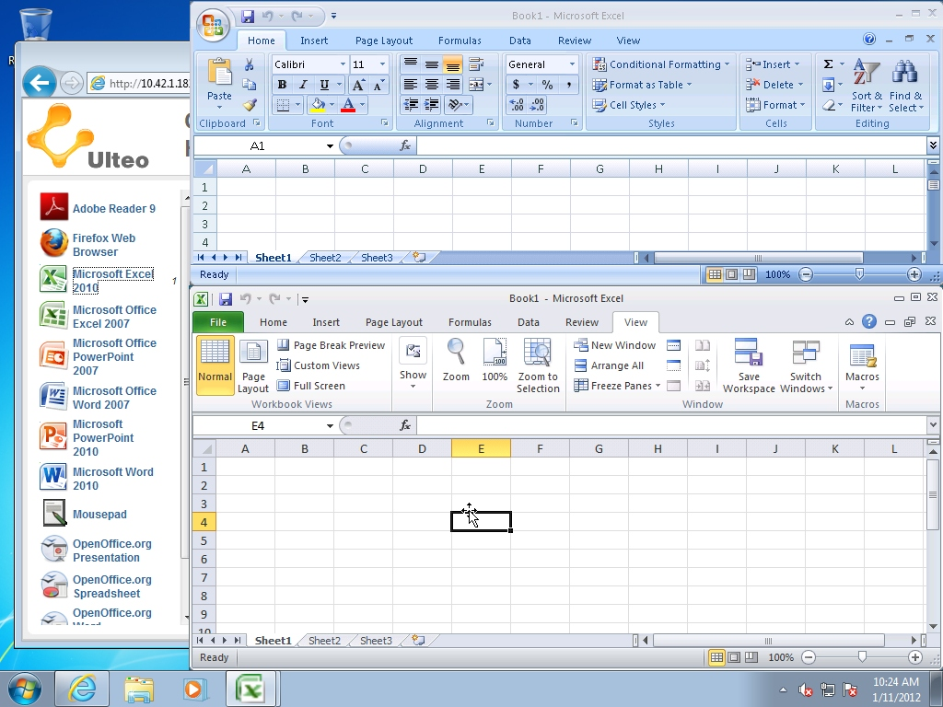
Application/Portal Mode Example
Portal mode, running two flavors of Excel

Slide 95

Application/Portal Mode Example
Application mode, with remote Windows & Linux applications integration on Windows 7 desktop

Slide 96

Application/Portal Mode Example
Applications mode, displaying the remote applications seamlessly on the local desktop

Slide 97

Application mode or Desktop mode with WAN access through OVD Gateway
Application Publishing, to get remote Windows and/or Linux applications seamlessly integrated in the local end-user desktop

Slide 98
User Clients
A web-browser(*)
A dedicated Ulteo client software for Linux or Windows PCs or thin clients
An iOS or Android tablet (desktop mode only)
(*) The web-browser needs a Java plugin to perform

Slide 99
References
Vmware VDI http://www.virtualizationadmin.com/articles-tutorials/vdi-articles/general/virtual-desktop-infrastructure-overview.html
Virtual Desktop Infrastructure http://ebookbrowse.com/03-david-young-vdi-ppt-d138117600
Virtual Desktop Infrastructure (VDI) Protocol Problem Statement http://wenku.it168.com/d_000070198.shtml
Microsoft Client Virtualization Strategy White Paper http://ebookbrowse.com/microsoft-client-virtualization-strategy-white-paper-final-brz-pdf-d216269211
Citrix http://flexcast.citrix.com/technology/hostedshared.html
Ulteo OVD http://www.ulteo.com/home

